Slide 1


Lending Club Case Study SUBMISSION
Group Facilitator: Pankaj Suryavanssi
Team Member: Harish Kumar

Slide 2






Lending Club Problem Statement and Requirements
Problem Statement:
When Lending Club receives a loan application, the company has to make a decision for loan approval based on the applicant’s profile.
Two types of risks are associated with the bank’s decision:
If the applicant is likely to repay the loan, then not approving the loan results in a loss of business to the company
If the applicant is not likely to repay the loan, i.e. he/she is likely to default, then approving the loan may lead to a financial loss for the company
Requirements:
Lending club wants to understand the driving factors behind loan default.
Lending club wants to understand driver variables which are strong indicators of default to utilize this analysis for its portfolio and risk assessment Funds
Approve Loan
Borrowers Apply for Loan
Verify & Analyze Borrowers Profile
Reject Loan

Slide 3
Approach to solve the problem
Understand the sample loan data provided for period 2007 to 2011
Clean the loan data with below steps
Check the percentage of missing values
Remove all those with very high missing percentage
For columns with less missing percentage: perform Imputations
Drop rows where the missing percentage is quite high
Perform Data Analysis on below variables
Variable related to the applicant (demographic variables such as age, occupation, employment details etc.),
Loan characteristics (amount of loan, interest rate, purpose of loan etc.) and
Customer behavior variables (those which are generated after the loan is approved such as delinquent 2 years, revolving balance, next payment date etc.).
Since customer behavior variables are not available at the time of loan application, and thus they cannot be used as predictors for credit approval.
Remove data with loan status as 'current’ and tag the Charged off as 0 and Fully Paid as 1.
Recommendations
Mention the finding of Univariate, Segmented Univariate and Multivariate Data analysis
Draw conclusion based on above analysis and provide recommendation to Lending club on key factors identified for loan default

Slide 4
Data Understanding and Data Cleaning
Data Set Details:
There are 39717 Rows and 111 Columns
Out of 111 Columns, 74 are float, 13 are int, and 24 are object
There are 54 Columns of which data is completely Null, which will require data cleaning
Unique Fields:
Id column is unique
member_id is unique
Field with null, NA and redundant values which will requirement data cleaning
application_type - INDIVIDUAL
collections_12_mths_ex_med - This column got 0 and NA value - 100%
Chargeoff_within_12_mths - Missing or 0 Value Percentage 100%
tax_liens - Missing or O value Percentage 100%
mths_since_last_record - Missing Value Percentage 93%
mths_since_last_delinq - Missing Value Percentage 65%
initial_list_status - f
pymnt_plan -n
id - Since id and member_id columns are having unique values, we can maintail only member_id column and drop the id column
next_pymnt_d - 98% Data is null
url, desc, title, zip_code, addr_state - We can't derive any co-relation from these columns

Slide 5
Univariate data Analysis
Univariate analysis: Below analysis has been performed on Loan data after cleaning
Variable | Top1 | Top2 | Top3 | Remarks
int_rate | 22 | 21 | 20 | The Default Probability Ranges between 35% to 49%, if the applicant given loan at 19% and above. Assumption: Considering 23% & 24% as outliers
grade | G | F | E | The Default Probability is upto 34% for Applicants with lower Grade(lower credit history)
purpose | small_business | other | medical | The Default Probability is 27% if the applicatant taking loan for small business. The debt_consolidation category also very close to medical (15%+)
loan_amnt_5k-derived from Loan amount | 35000 | 25000 | 30000 | The Default Probability is upto 25% if the given loan amount is above 20,000.
terms | 60 months | 36 months |  | The Default Probability is upto 25% for Applicants with loan term is 60 months
annual_inc_10k-derived from annual income | 10000 | 20000 | 30000 | The Default Probability is upto 24% if the applicatant Annual income below 40,000. Assumption: Income has been segmented into nearest 10K, and outliers has been removed
Dtiq-Derived from DTI | 30 | 25 | 20 | The Default Probability gradually increases from 12 to 16% as DTI percetange increases.
emp_length | 10 | 0 | 7 | No specific pattern found with the Employement Period of applicant
verification_status | Verified | Source Verified | Not Verified | No specific pattern found with the Employement Period of applicant.

Slide 6
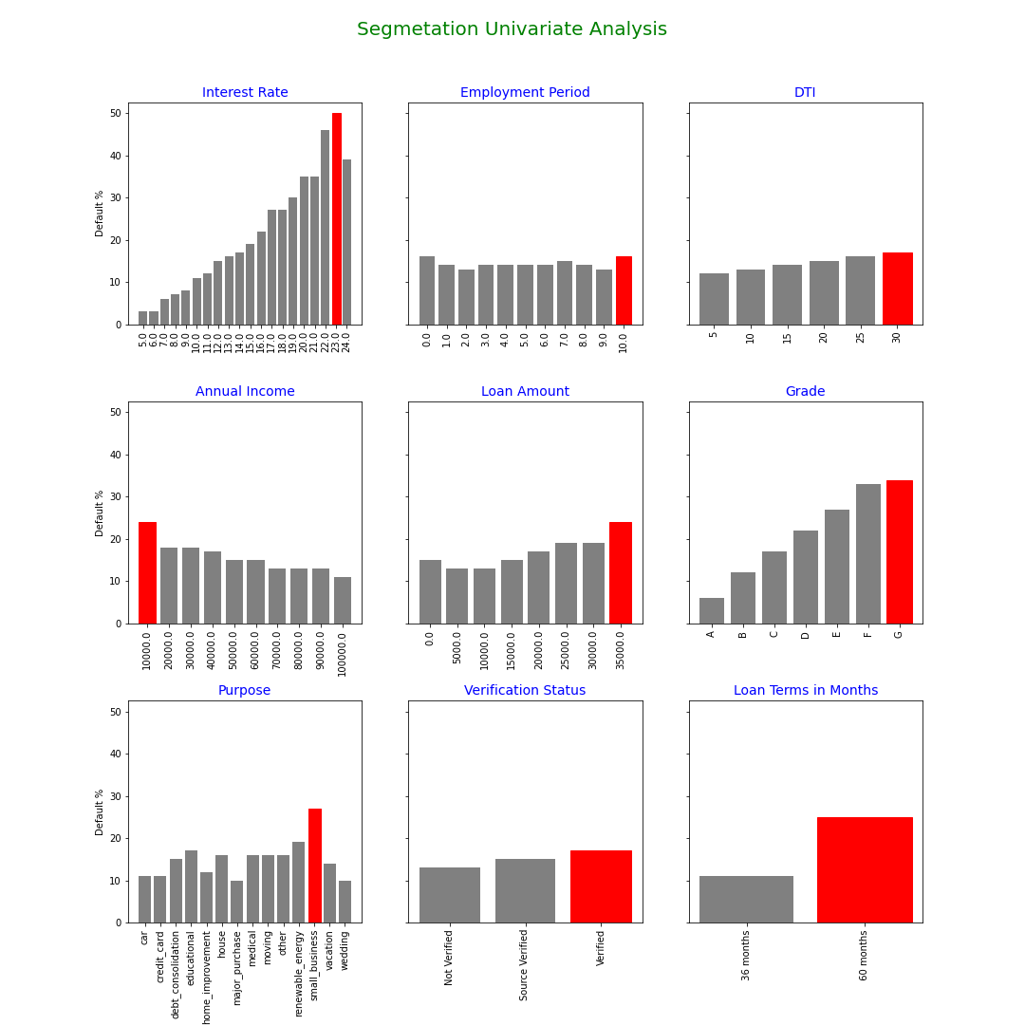
Univariate Data Analysis
Univariate analysis: Below are the graphical representation of Univariate analysis.

Slide 7
Univariate data Analysis-Top 3 Findings
The probability of default is upto 49% for the loans with Higher Interest Rate
The probability of default is upto 34% for the application with Lower Credit History/Grade
The probability of default is upto 37% for the loans taken for the purpose of Small Business
Assumption: Grade are considered in decreasing order, A is considered as higher grade(customer with highest credit history) and Grade G is considered as lowest grade(customer with worst credit history)

Slide 8
Multivariate data Analysis
'Default % Calculation for Grade & Loan Amount
Grade | Loan amount | # Charged Off | # Fully Paid | % of Default
F | 25000 | 69 | 111 | 38
F | 20000 | 62 | 121 | 34
F | 15000 | 52 | 112 | 32
E | 25000 | 92 | 219 | 30
E | 20000 | 113 | 287 | 28
E | 10000 | 157 | 413 | 28
D | 0 | 66 | 203 | 25
E | 15000 | 126 | 377 | 25
E | 5000 | 118 | 363 | 25
D | 20000 | 117 | 395 | 23

Slide 9
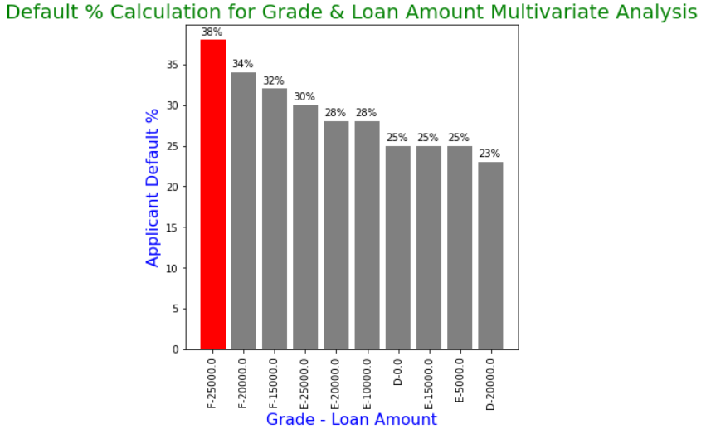
Multivariate data Analysis(Graphical representation and Conclusion)
Conclusion: Up to 38% Applicants with lower Grade(lower credit history), and if given an higher loan amount having high probability of getting defaulted
Assumption: Grade are considered in decreasing order, A is considered as higher grade(customer with highest credit history) and Grade G is considered as lowest grade(customer with worst credit history)

Slide 10
Multivariate data Analysis
Default % Calculation for Annual Income & Interest Rate
Annual_Income | int_rate | Charged Off | Fully Paid | % of Default
60000 | 19 | 53 | 93 | 36
60000 | 17 | 67 | 147 | 31
40000 | 17 | 61 | 141 | 30
50000 | 17 | 51 | 143 | 26
30000 | 16 | 56 | 172 | 25
70000 | 16 | 54 | 169 | 24
50000 | 16 | 94 | 298 | 24
60000 | 16 | 81 | 275 | 23
40000 | 14 | 103 | 348 | 23
30000 | 13 | 102 | 343 | 23

Slide 11
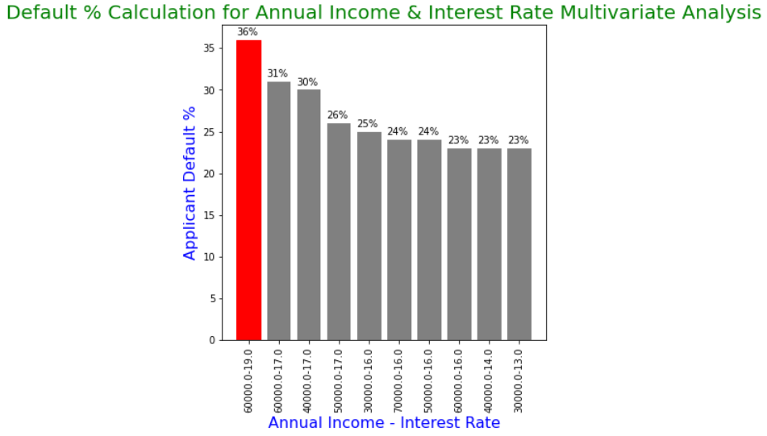
Multivariate data Analysis(Graphical representation and Conclusion)
Conclusion: Up to 36% applicants with mid-tier income, and if given loan at above 15% interest rate, having high probability of getting defaulted.

Slide 12
Multivariate data Analysis
Default % Calculation for Purpose & Debt To Income
Purpose | DTIQ | Charged Off | Fully Paid | % of Default
small_business | 25 | 74 | 148 | 33
small_business | 30 | 58 | 140 | 29
small_business | 20 | 63 | 154 | 29
small_business | 15 | 75 | 200 | 27
small_business | 10 | 98 | 277 | 26
small_business | 5 | 107 | 360 | 23
other | 25 | 108 | 471 | 19
other | 30 | 108 | 454 | 19
other | 15 | 101 | 469 | 18
debt_consolidation | 30 | 618 | 2925 | 17

Slide 13
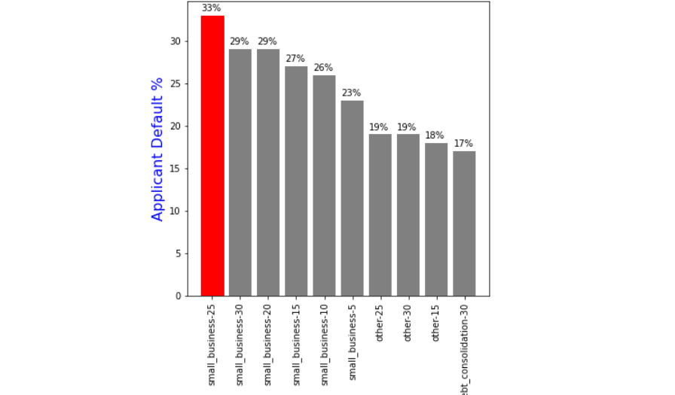
Multivariate data Analysis(Graphical representation and Conclusion)
Conclusion: Up to 33% applicants with higher DTI, and if loan taken for the purpose of Small Business, having high probability of getting defaulted

Slide 14
Conclusion
Applicant with Lower Credit Grade(E,F,G), should not be given higher loan amount(more than 25K)
Applicant with Mid Tier annual income(30K to 60K) should be charged higher interest rate and reduce the loan amount
Applicant with Higher Debt to Income(more than 15) should not be give loan for Small Business purpose, and reduce the loan amount
Applicant should not be charged more than 19% reduce the probability of becoming defaulter

